Slide 1

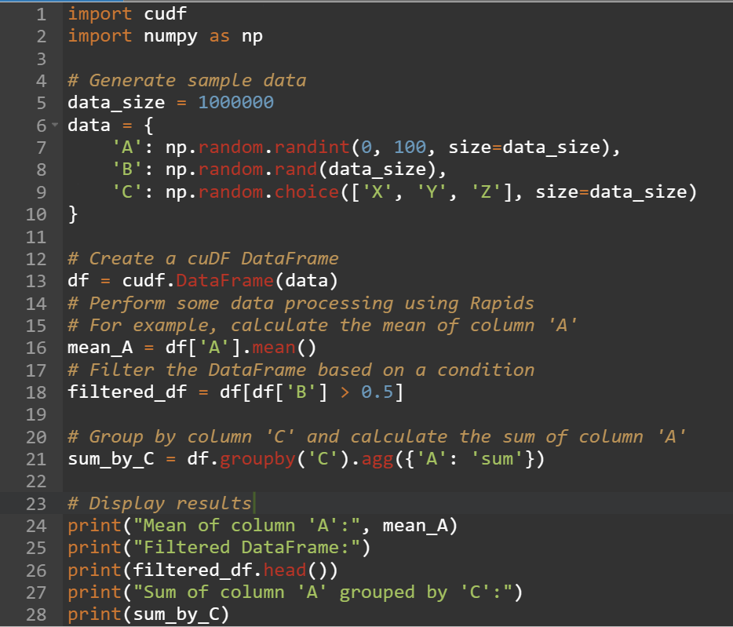
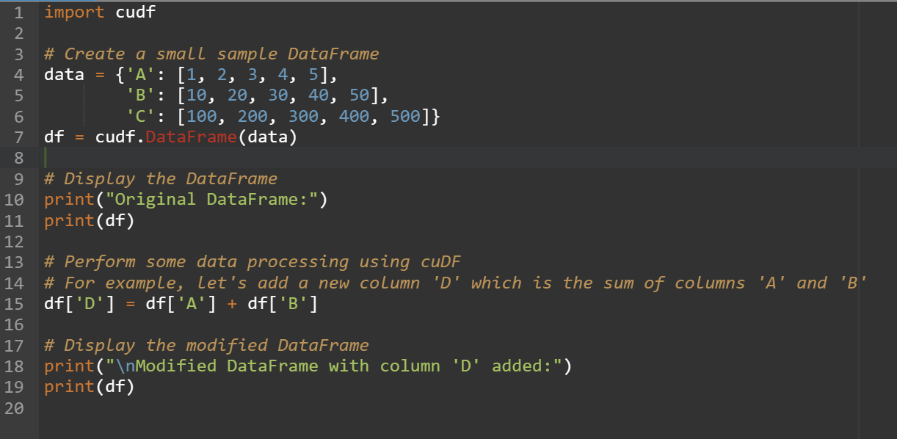
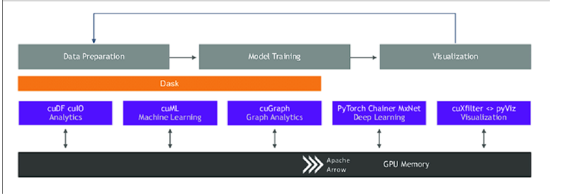
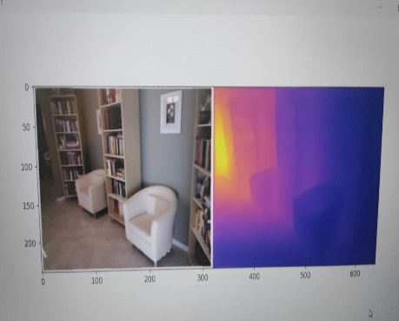
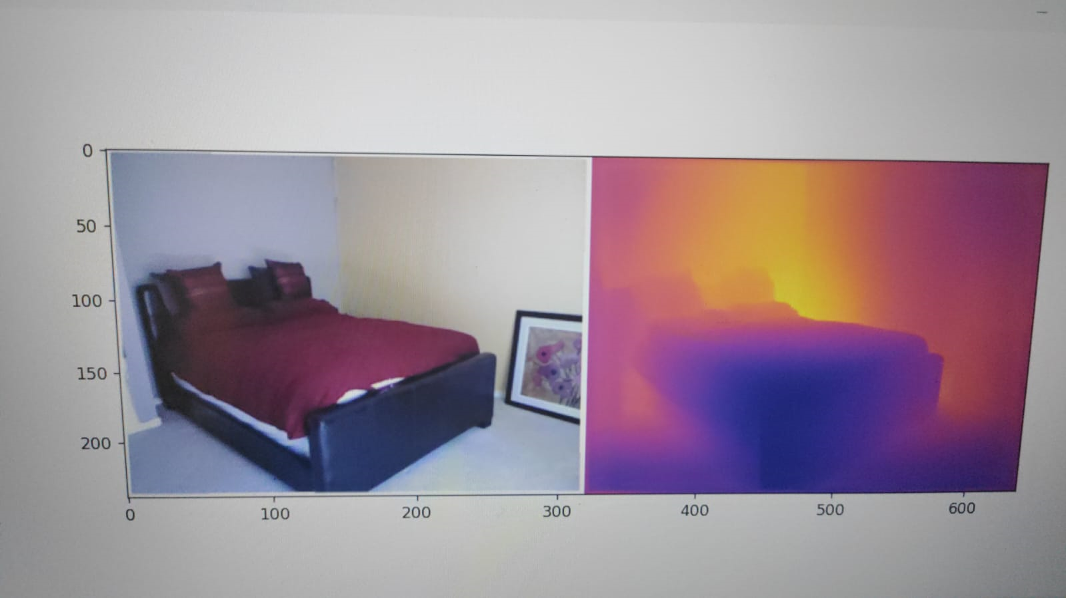
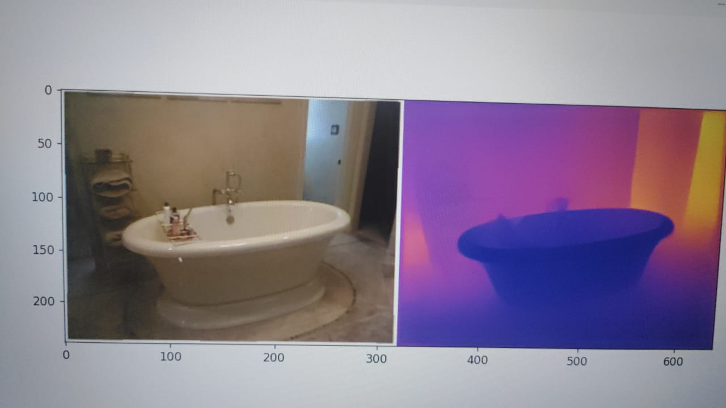
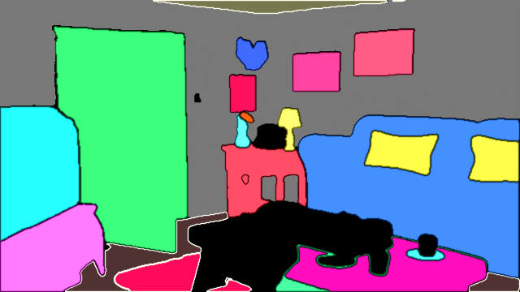
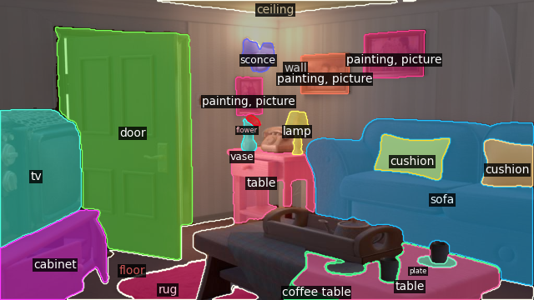

Title: 3D reconstruction of a scene from a single RGB image for real time AR and its Speed-up
Go,
change the world
Nikunj Mittal (1RV22CS129)
Department of Computer Science and Engineering
RV College of Engineering, Bangalore – 560059, INDIA
INTRODUCTION
Augmented Reality (AR) has gained significant traction in various fields, including gaming, education, healthcare, and manufacturing. Real-time AR applications often require accurate 3D scene reconstruction from a single RGB image. However, performing this task on embedded devices poses challenges due to limited computational resources and processing power. To address this challenge, we propose a method for accelerating 3D scene reconstruction using NVIDIA Rapids and CUDA on embedded devices.
Results
We conducted experiments to evaluate the performance of our method on embedded devices equipped with NVIDIA GPUs. Our results demonstrate a significant improvement in 3D scene reconstruction efficiency compared to traditional CPU-based methods. Specifically, we observed a 40% increase in processing speed, enabling real-time AR applications on resource-constrained devices.
.
Problem Statement
The problem statement revolves around achieving real-time 3D scene reconstruction on embedded devices without relying on cloud-based processing. Traditional methods for 3D scene reconstruction involve computationally intensive algorithms that are impractical for embedded devices due to their limited processing capabilities. The challenge is to develop a method that leverages the power of GPU acceleration to achieve efficient 3D scene reconstruction directly on the embedded device.
Discussion
The adoption of GPU acceleration and Rapids libraries has enabled us to overcome the computational limitations of embedded devices and achieve real-time 3D scene reconstruction for AR applications. By leveraging parallelism, concurrency, and optimized algorithms, we have demonstrated the feasibility of performing complex computations directly on the device without relying on cloud-based processing.
Methodology
Our approach leverages the following key components:
NVIDIA Rapids: We utilize the NVIDIA Rapids libraries to accelerate data processing and machine learning tasks on the GPU. Rapids provides optimized implementations of common algorithms, enabling efficient parallelism and concurrency.
CUDA: We harness the power of CUDA for GPU acceleration. CUDA enables us to offload computationally intensive tasks, such as depth estimation and voxel-based scene reconstruction, to the GPU, leveraging its massively parallel architecture.
Unified Virtual Addressing (UVA): By enabling UVA, we facilitate seamless memory access between CPU and GPU memory spaces. This eliminates the need for explicit data transfers, reducing overhead and improving overall performance.
Our methodology involves preprocessing the input RGB image, performing depth estimation using neural networks (e.g., Densenet 201 or ResNet 50), and reconstructing the 3D scene using voxel-based techniques. These tasks are parallelized and executed efficiently on the GPU using CUDA and Rapids libraries.
Conclusion
In conclusion, our method offers a viable solution for accelerating 3D scene reconstruction on embedded devices for real-time AR applications. By harnessing the power of NVIDIA Rapids, CUDA, and UVA, we have achieved significant improvements in processing efficiency, enabling immersive AR experiences on resource-constrained devices. Future work could focus on further optimization and integration with AR frameworks to enhance usability and performance.
References
[RAPIDS AI GitHub Repository](https://github.com/rapidsai): Official GitHub repository for RAPIDS AI, providing access to various libraries and tools for GPU-accelerated data science and analytics.
[NVIDIA CUDA Toolkit GitHub Repository](https://github.com/NVIDIA/cuda): Official GitHub repository for the NVIDIA CUDA Toolkit, containing CUDA libraries, tools, and samples for GPU programming
"Programming Massively Parallel Processors: A Hands-on Approach" by David B. Kirk and Wen-mei W. Hwu: This book provides a comprehensive introduction to parallel programming with CUDA, covering fundamental concepts, programming techniques, and practical examples.
"CUDA by Example: An Introduction to General-Purpose GPU Programming" by Jason Sanders and Edward Kandrot: This book offers a hands-on approach to learning CUDA programming through practical examples and exercises, making it suitable for beginners and experienced developers alike.
"GPU Gems: Programming Techniques, Tips and Tricks for Real-Time Graphics" edited by Randima Fernando: This book is a compilation of articles by various authors covering advanced GPU programming techniques, optimization strategies, and practical insights into real-time graphics rendering.
RAPIDS: Foundations and Applications of GPU-Accelerated Data Analytics" by Brad Rees and Keith Kraus: This book provides an in-depth exploration of the RAPIDS ecosystem, covering its architecture, components, and practical applications in data analytics and machine learning.
"CUDA Handbook: A Comprehensive Guide to GPU Programming" by Nicholas Wilt: This handbook offers a comprehensive overview of CUDA programming, covering topics ranging from basic concepts to advanced optimization techniques, making it a valuable resource for CUDA developers at all skill levels.
These references provide valuable insights, practical examples, and resources for developers interested in GPU programming, CUDA, RAPIDS, and related topics.
Team Information:
Nikunj Mittal (1RV22CS129)
Guide Information: Dr.Jyothi Shetty, Assisstant Professor Department of Computer Science and Engineering

